Slide 1
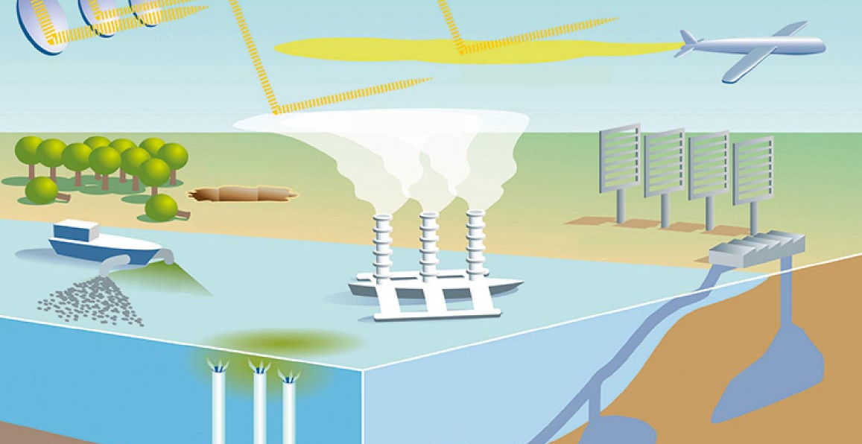
Climate Change Impact on Air, Water & Temperature
Project 3
Contributors
Julia Lira
Ahmed Dahham
Uma Yeruva,
Samantha Brown
This Photo by Unknown Author is licensed under CC BY-SA-NC

Slide 2
